Slide 1
Where is all the Ice Going?
Name: _______________________________ ____ Date:____________Period_______
Gallery Walk Evidence Log
Location | My observations are... | Comparing to the “Ice Ages Video” My inferences are...
Developed by the NGSS Curriculum Consortium under the guidance of Jaime E. Rechenberg, Ed. D. © 2017 Capitol Region Education Council (CREC).

Slide 2
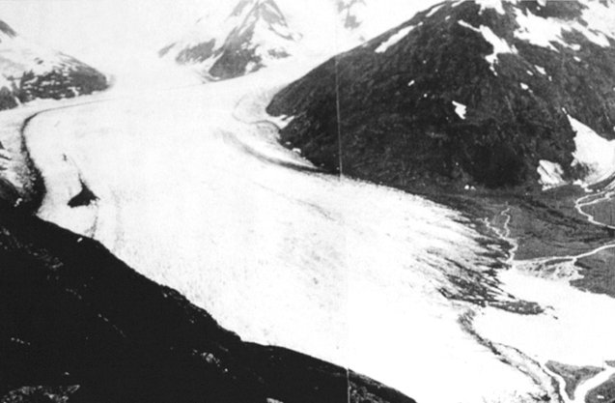
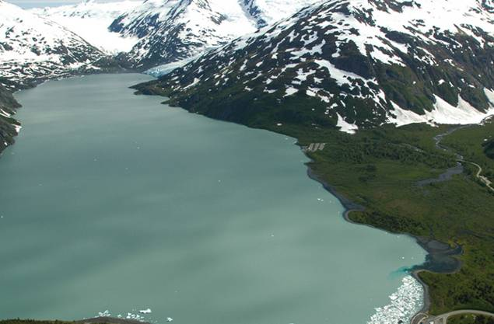
Portage Glacier
Alaska
1914
2004
Photos: NOAA Photo Collection and Gary Braasch – WorldViewOfGlobalWarming.org

Slide 3
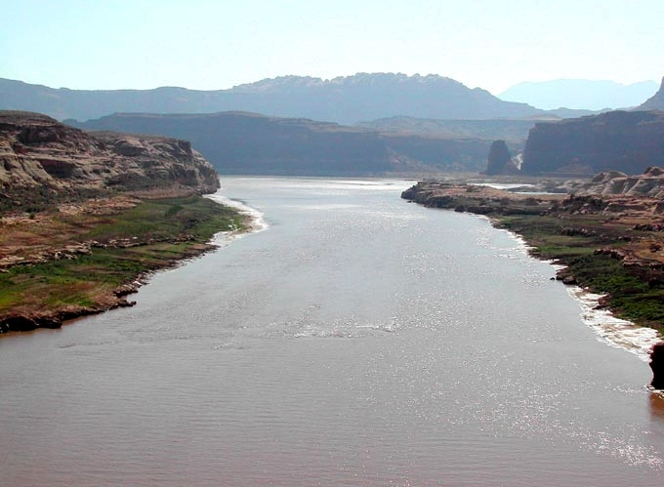
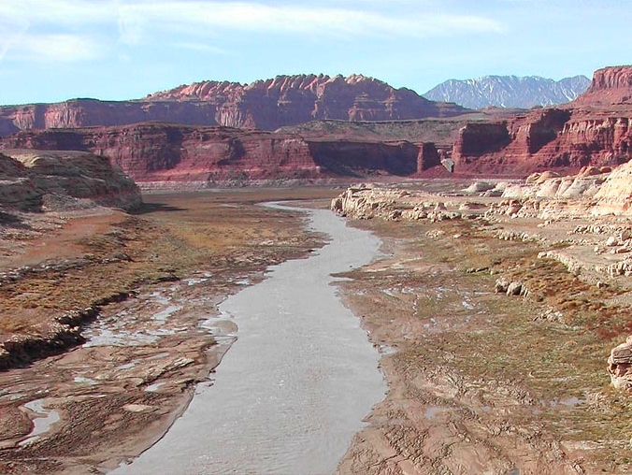
Colorado River
Arizona
June 2002
Dec 2003
Photos: NOAA Photo Collection and Gary Braasch – WorldViewOfGlobalWarming.org

Slide 4
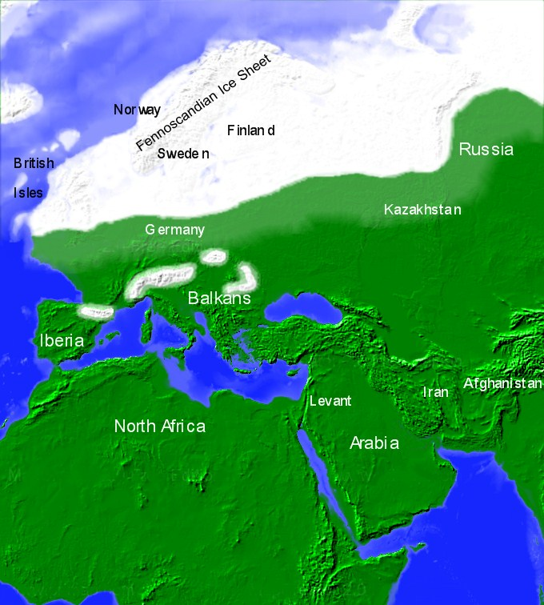
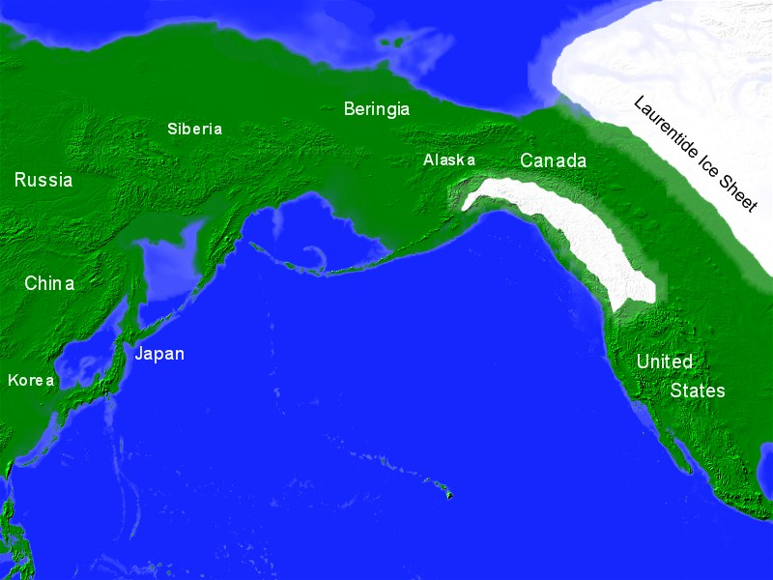
Europe, Africa and N. America
20,000 years ago
Maps: http://mail.lsmsa.info/map-of-america-20000-years-ago.html

Slide 5
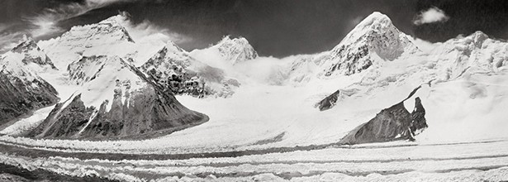
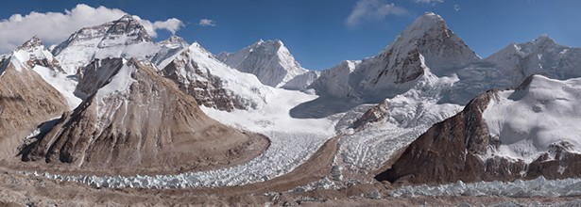
Mount Everest
http://more.glacierworks.org/glacier/west-rongbuk-glacier/
1921
2008

