Slide 1
Environmental Systems and Feedback Loops

Slide 2
What is a System?
Environmental System: Interacting parts that work together and influence one another by exchanging energy or materials
Examples:
Ocean
Rainforest
River

Slide 3
Feedback Loops
Results when an “input” to a system causes a change to a system “output”…
Then that change causes the input to change
Let’s look at a microphone as an example
Input
Output affects input
Input affects output
Output

Slide 4
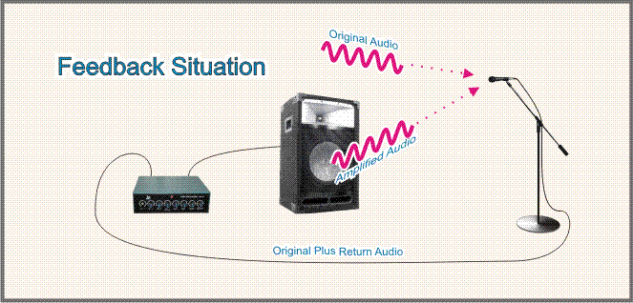
3. Which creates more sound going into microphone and the loop continues
1. Input: Talking/sound into microphone
2. Results in sound coming out of speaker

Slide 5
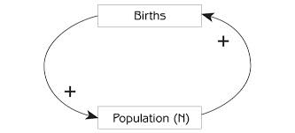
Positive Feedback
An input increase causes an output increase
An input decrease causes an output decrease
Example: Population Growth

Slide 6
Positive Feedback
“Positive” does not mean “good”. It refers to the overall increase or decrease in the output. (the result can be good or bad overall)
Example: Deforestation = fewer plants to hold soil in place = erosion
erosion
Leads to more
Leads to
fewer plants

Slide 7
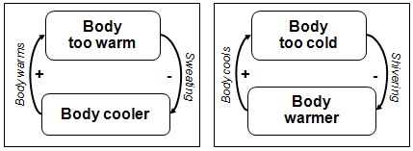
Negative Feedback
An input increase causes an output decrease
An input decrease causes an output increase
Result = stabilization of a system
Example: Sweating or shivering to maintain body temperature

Slide 8
Environmental Systems
VERY complex interactions of positive and negative feedback loops that over time have reached a “steady state” or “equilibrium”
Human interference of these systems creates “unsteady states”, which can harm the environment
Often unintentional or unforeseen
Returning to “steady state” can be difficult

